Slide 1

Bank Marketing Campaign Project
Presenter: Abhinay Kumar Singampalli

Slide 2

Introduction
Problem: The Portuguese banking institution has initiated a campaign to target their customers to enroll in a term deposit program. However, the process of reaching out to all customers via phone calls requires significant resources, time, and cost.
Motivation: The goal of this project is to identify the customers who are most likely to enroll in the term deposit program and benefit the banks by saving resources, time and cost.
Notes:
The model will enable the banking institution to focus their resources on those customers who are more likely to subscribe and increase the success rate of their campaign.

Slide 3

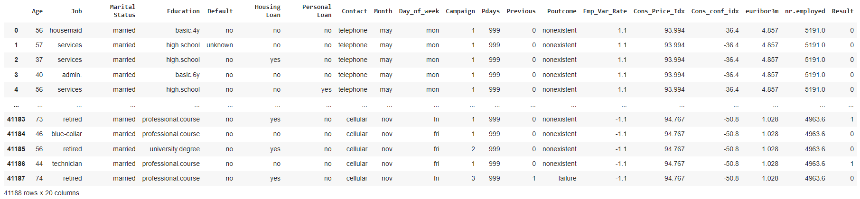
Bank Marketing Dataset
Source: Kaggle
Link: https://www.kaggle.com/datasets/ruthgn/bank-marketing-data-set
41188 Rows and 20 Columns
10 Categorical Variables, 10 Numeric Variables
Target: Result column (has the client subscribed for a term deposit?)

Slide 4
Variable Description
Variable | Type | Description
Age | Continuous | Age of the customer
Job | Nominal | The job of the customer
Marital Status | Nominal | Marital status of the customer
Education | Nominal | Educational background of the customer
Default | Nominal | Has the customer had credit in default?
Housing Loan | Nominal | Has the customer had a housing loan?
Personal Loan | Nominal | Has the customer had a personal loan?
Contact | Nominal | Medium of communication with the customer
Month | Nominal | The month in which the customer was last contacted
Day_of_Week | Nominal | Last contacted day of the week
Campaign | Continuous | No of contacts done with the customer in this campaign
Pdays | Continuous | No of days passed from the last day of contact in this campaign
Previous | Continuous | No of contacts performed before this campaign for this month
Poutcome | Nominal | The outcome of the previous marketing campaign
Emp.Var.Rate | Continuous | Employment variation rate - quarterly indicator
Cons.Price.Idx | Continuous | Consumer price index - monthly indicator
Cons.Conf.Idx | Continuous | Consumer confidence index - monthly indicator
Euribor3M | Continuous | Euribor 3-month rate - daily indicator
Nr.Employed | Continuous | No of employees - quarterly indicator
Result | Nominal | Has the client subscribed to the term deposit?

Slide 5
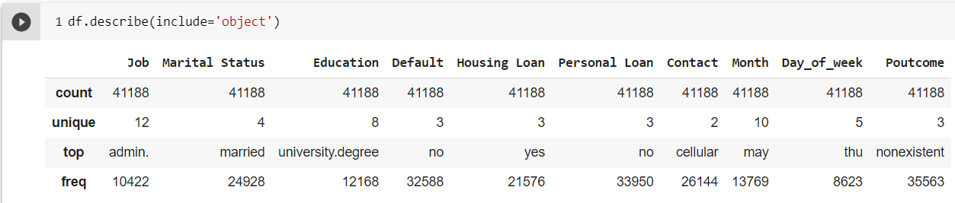
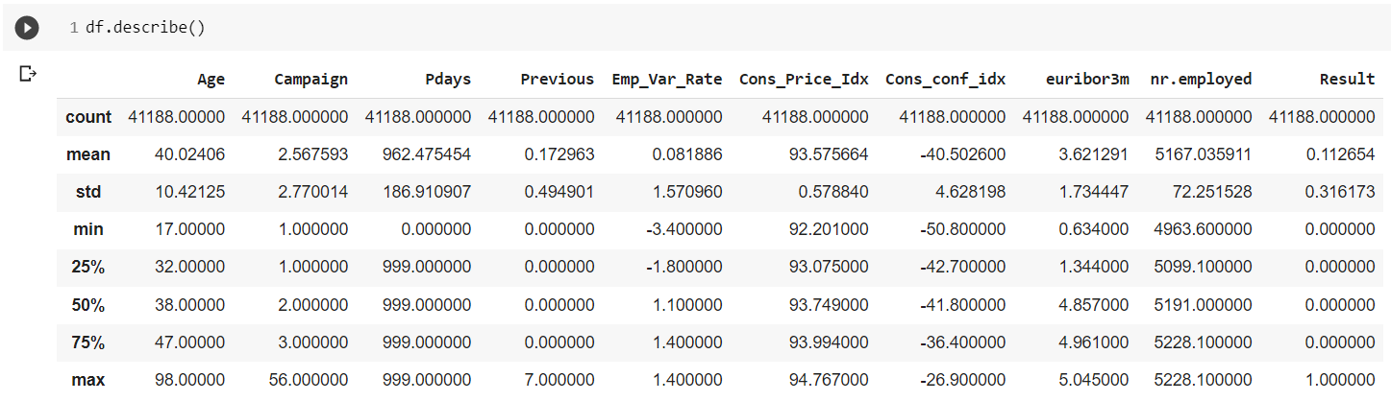
Data Description

Slide 6
Target Variable Distribution
6

Slide 7
Literature
7
Others Did
We Did
Used OneHotEncoder to convert categorical variables to continuous.
Used shorter quantile range and intervals for outlier analysis.
Tried only SVM and Logistic Regression models.
Age column is taken as continuous
Used LabelEncoder to reduce the model complexity.
Used wider quantile range and intervals for outlier analysis.
Fitted many other models and achieved better accuracy.
Age column was transformed to categorical by data binning

Slide 8
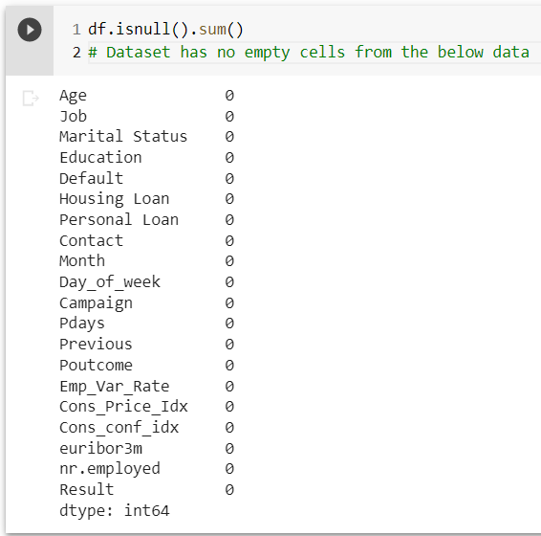
Data Preprocessing and Modification
Missing Values
The dataset has no empty cells.
But few columns have value ‘unknown’ in the dataset

Slide 9
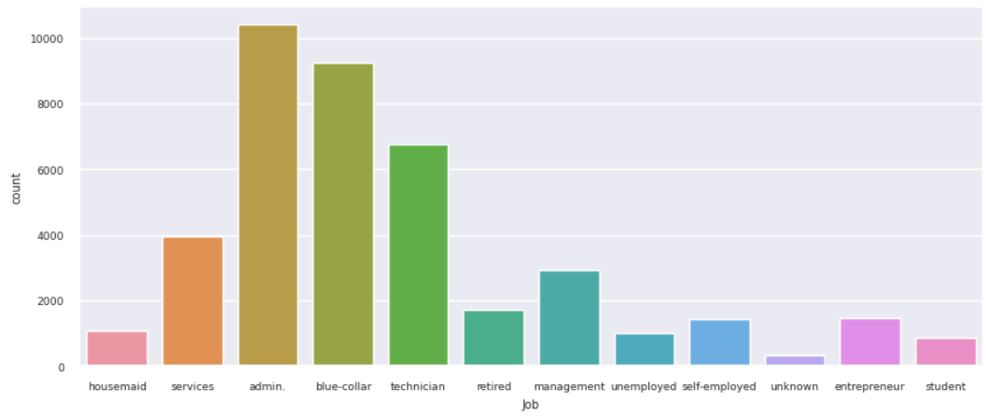
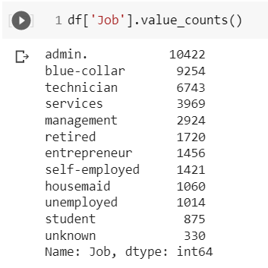
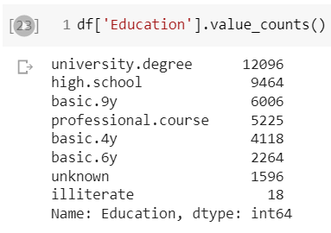
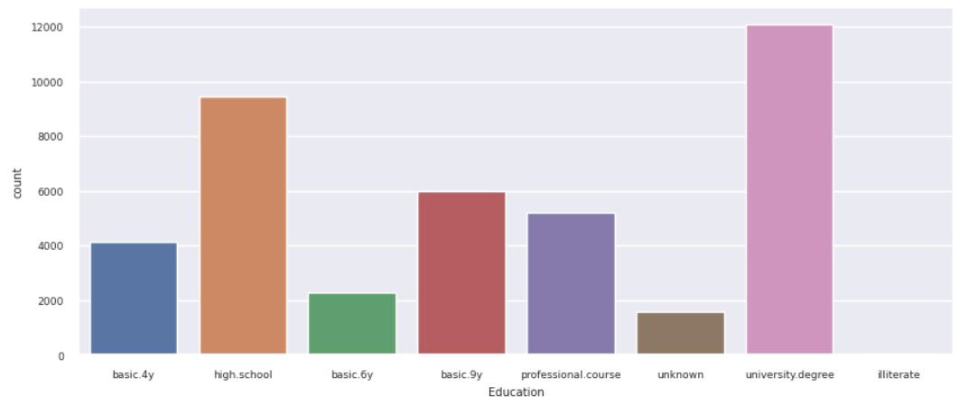
Data Preprocessing and Modification
Missing Values

Slide 10
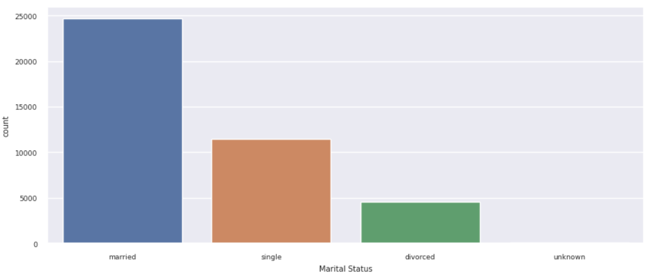
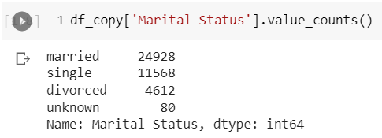
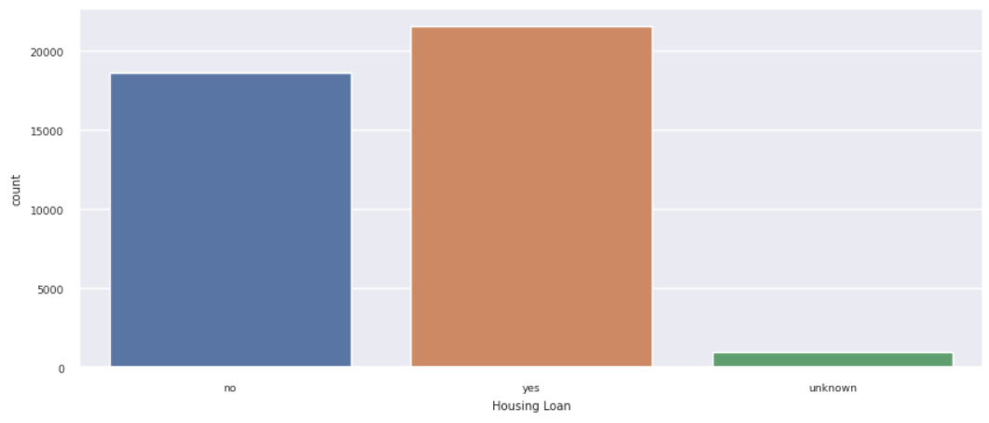
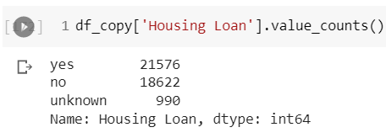
Data Preprocessing and Modification

Slide 11
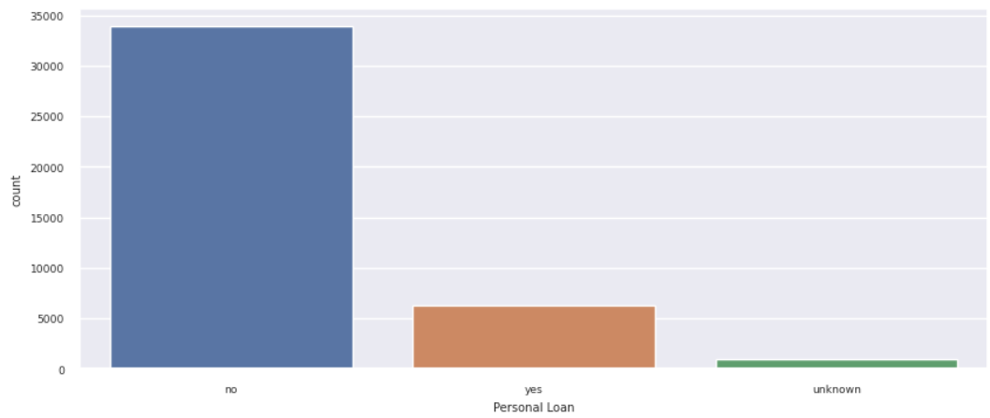
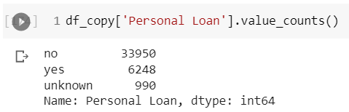
Data Preprocessing and Modification
The variables ‘Job’, ‘Education’, ’Marital Status’, ‘Housing Loan’, ‘Personal Loan’ has value ‘unknown’.
Considering those as missing values, those rows were eliminated from the dataset.
A total of 2961 rows were eliminated under missing value elimination.

Slide 12
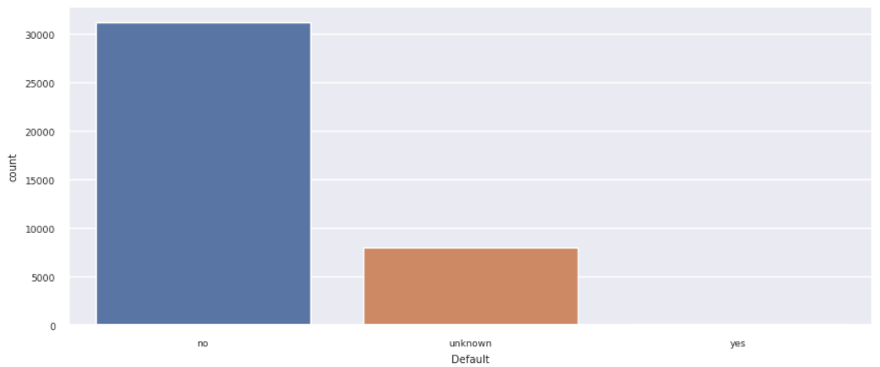
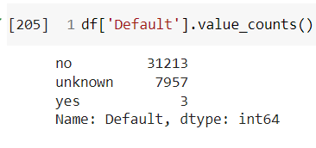
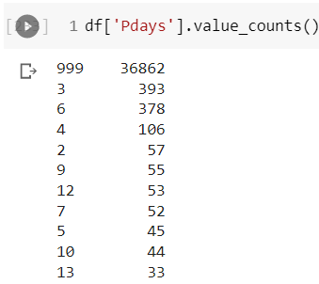
Data Preprocessing and Modification
12
Column Elimination
The variable ‘default’ has 21% ‘unknown’ value and only 3 rows with yes.
If we remove ‘unknown’ and ‘yes’ rows there will be a constant value ‘no’ left in the dataset. So, column ‘default’ was eliminated.
The column Pdays has 96% value ‘999’. Which can be a default value for ‘unknown’. So, the column Pdays was eliminated.

Slide 13
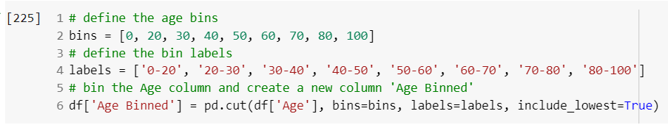
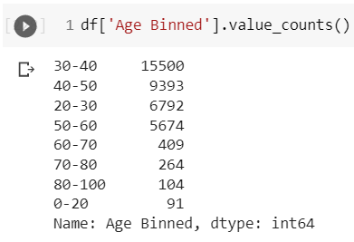
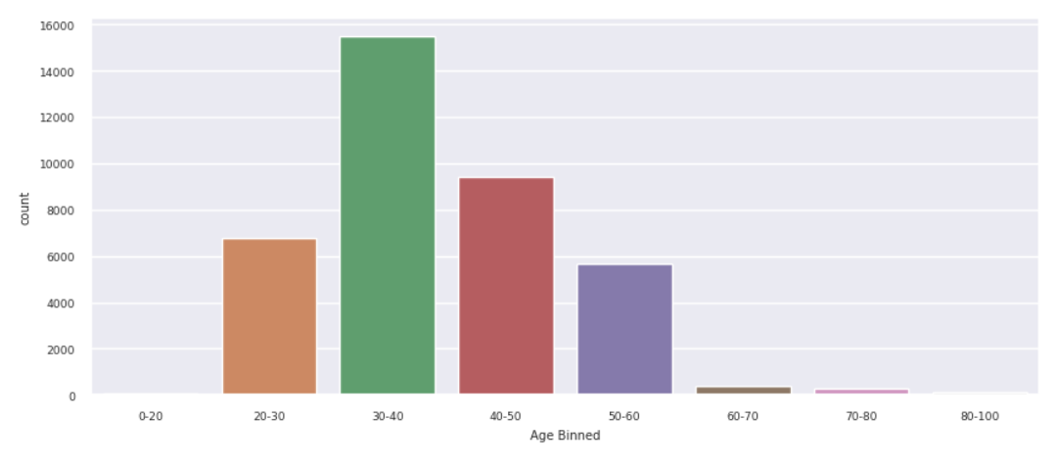
Data Preprocessing and Modification
13
Column Transformation
The ‘Age’ column was transformed to categorical by data binning with intervals of 10. and a new column was created with name ‘Age Binned’.

Slide 14
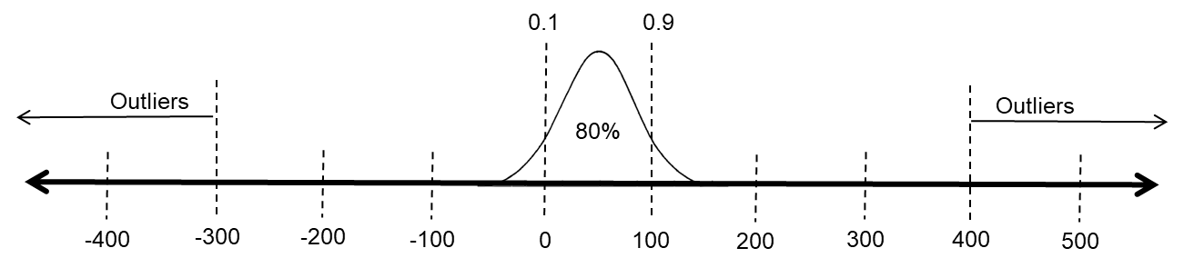
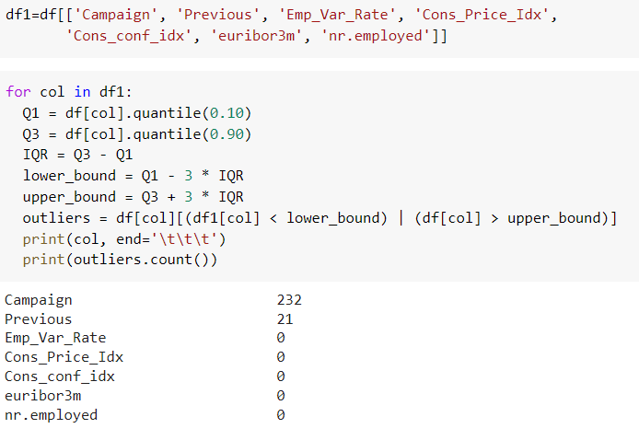
Data Preprocessing and Modification
Outlier Analysis
Lower Quantile = 10%.
Upper Quantile = 90%.
Q (No of tolerable intervals) = 3
There are a total of 253 outliers in the dataset in columns ‘Campaign’ & ‘Previous’. Those 253 rows were eliminated from the dataset.
After the completion of data modification and transformation, there are 37974 rows and 18 columns in the data set.

Slide 15
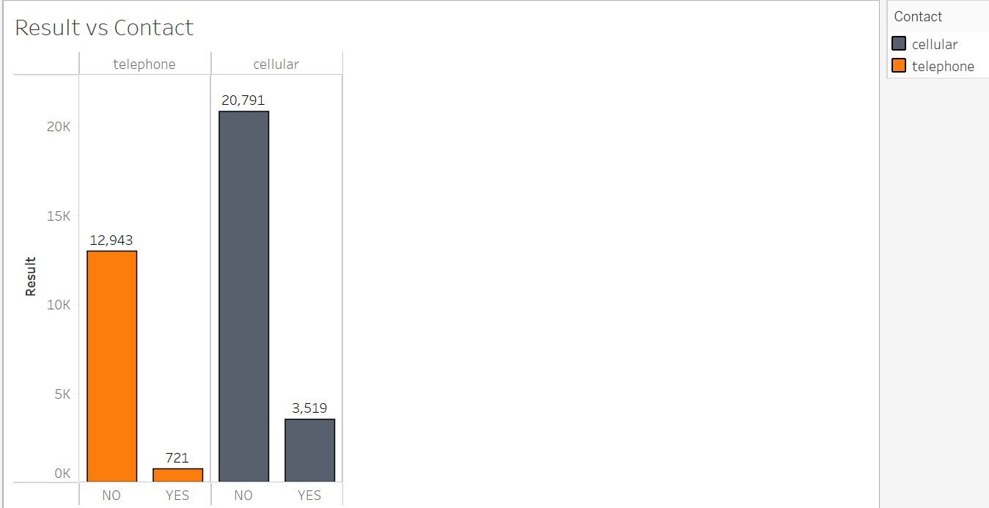
Data Exploration
The Probability of customers enrolling to term deposit is ~3 times higher when contacted via cellular than when contacted via telephone

Slide 16
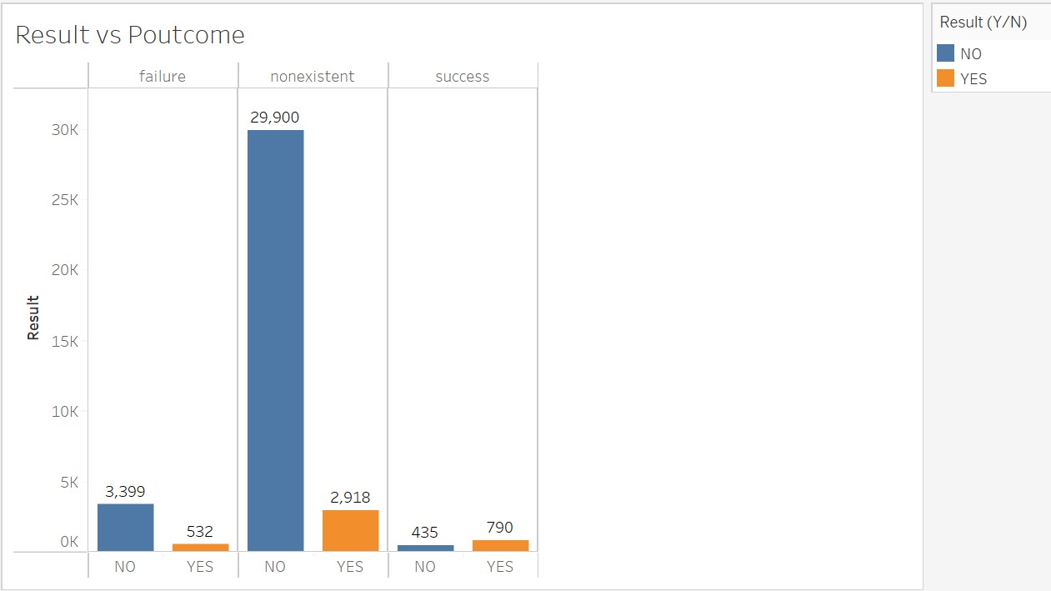
Data Exploration
There are high chances of customers enrolling to term deposit in this campaign when the customers have enrolled for it in the previous campaign.

Slide 17
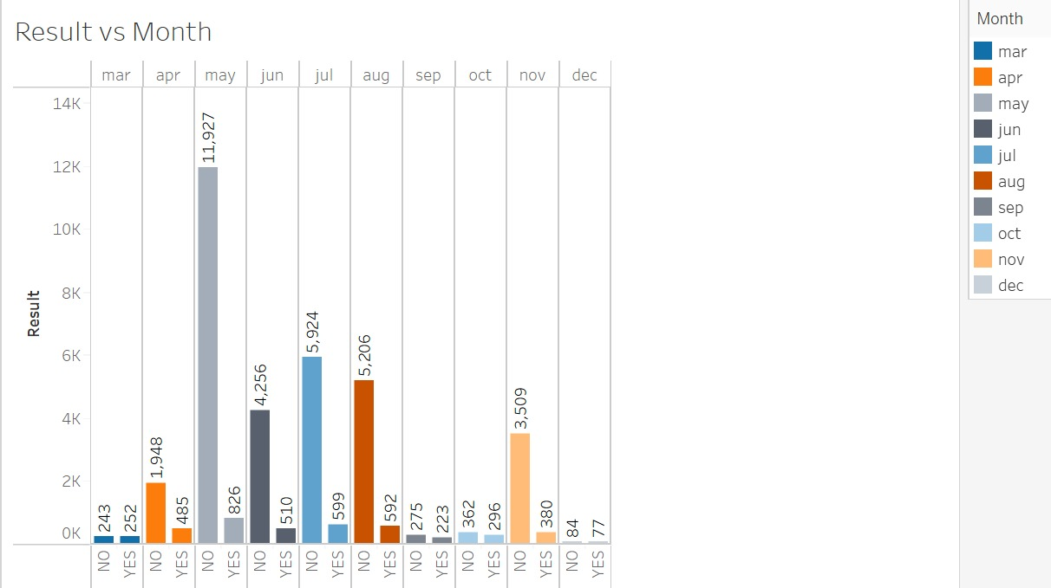
Data Exploration
The probability of customers enrolling to the term deposit when contacted in months March, September, October, and December is ~50%.

Slide 18
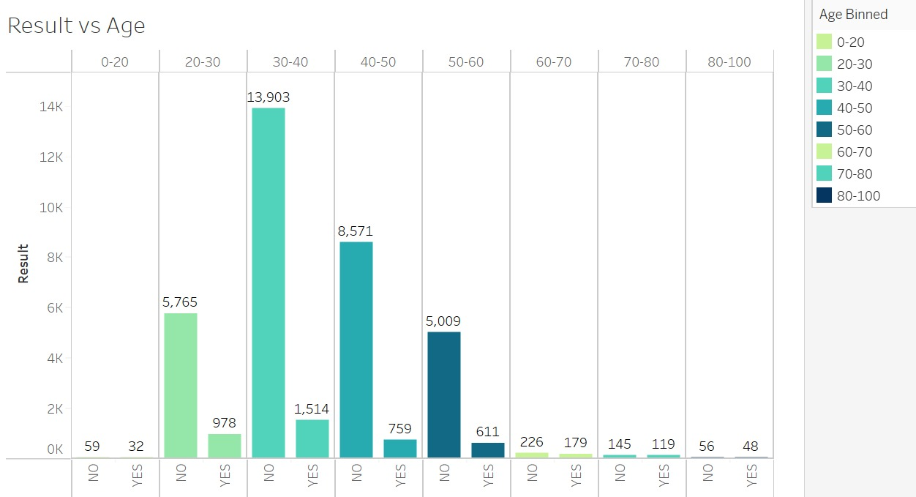
Data Exploration
18
The chance of people to enroll to term deposit with age above 50 is higher when compared to people with age below 50.

Slide 19
Modelling
19
Logistic Regression
Decision Tree
Random Forest
Gradient Boosting
Models trained

Slide 20
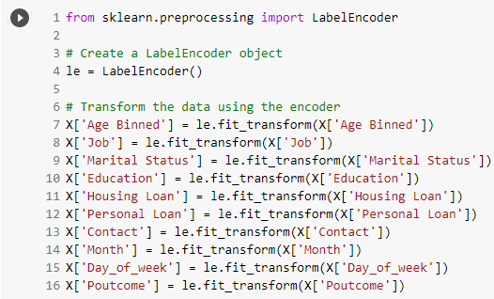
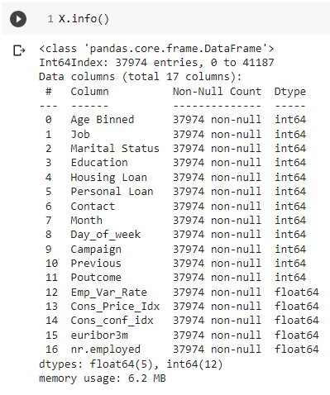
Modelling
20
Data Transformation
As there are 10 categorical variables in the final cleaned data set, these categorical variables are transformed to continuous variables.
Tried “OneHotEncoder” and “get_dummies” to perform the task. But by increasing the no of dummy variables can increase the complexity of the model, transformation was done using the “LabelEncoder”

Slide 21
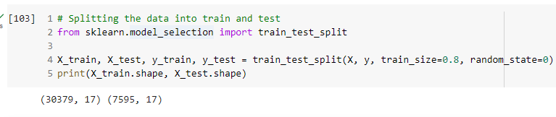
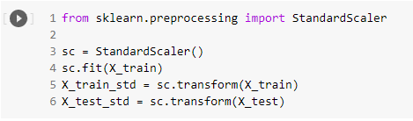
Modelling
21
Data Split
The data was split into training and test with 80% of data to train the models.
Data Standardization
The data standardization technique was applied to the data using the Standard Scalar function.

Slide 22
Modelling
22
Model Selection
Model | Total Accuracy | Precision | Lift | AUC
Logistic Regression | 90% | 64% | 5.7 | 0.7720
Decision Tree | 85% | 31% | 2.76 | 0.6214
Random Forest | 89% | 53% | 4.72 | 0.7704
Gradient Boosting | 90% | 64% | 5.7 | 0.7877
From the above metrics, it is evident that ‘Gradient Boosting’ models outperforms all the other models with higher Accuracy, Precision, Lift & AUC values.

Slide 23
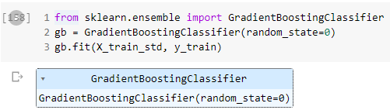
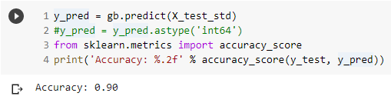
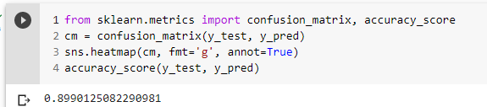
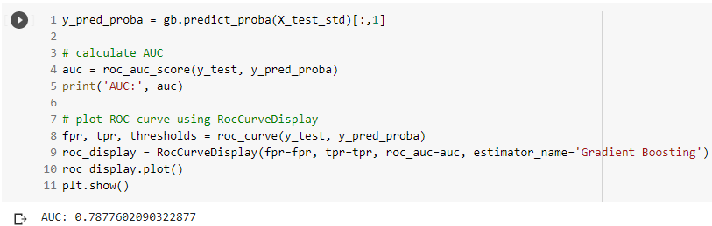
Modelling
23
Code

Slide 24
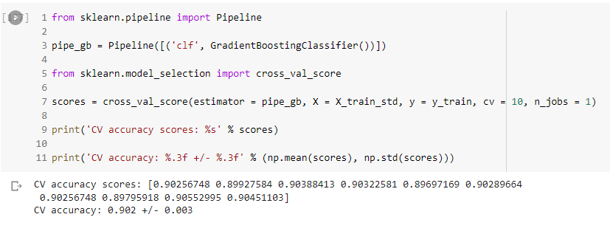
Modelling
24
Cross validation
Cross validation is applied on the training set for Gradient Boosting model to verify the accuracy of the model.
The mean of the scores is 0.902 with a standard deviation of 0.03.

Slide 25
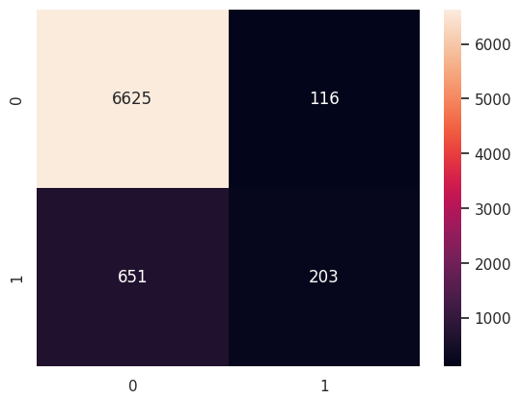
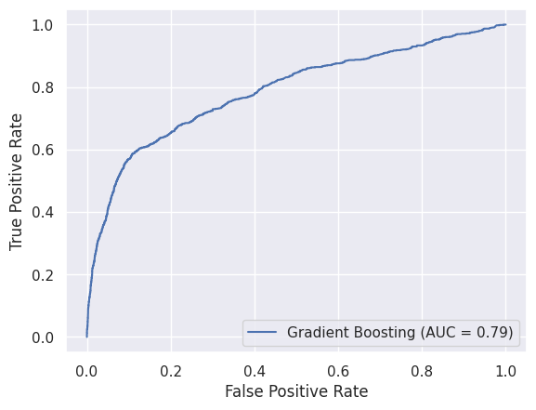
Modelling
25
Gradient Boosting
Confusion Matrix
ROC Curve

Slide 26
Business Recommendations
26
We can see that the customers who has enrolled to term deposit in the previous campaign are more likely to be enrolled for the term deposit again. So, the banks can prioritize those customers.
As the probability for customers to enroll for the term deposit is high when the customers were contacted in months March, September, October, and December, banks can plan to arrange more calls to customers during these months.
The banks to contact the customer on cellular instead of telephone to contact the right person to whom the call was intended and convince them to enroll.
The banking institutions can arrange virtual meetings with the customers to increase the interaction and provide add on benefits to convince them to enroll for term deposit.

Slide 27
References
27
Kaggle: https://www.kaggle.com/datasets/ruthgn/bank-marketing-data-set/code
Scikit – learn: https://scikit-learn.org/stable/index.html
Data Science with Python, In class colab files.
Predictive Modeling lectures.

Slide 28
Project Colab
Project colab link

Slide 29
=========Thank You=========

